Slide 1

CSS presentation 1st to 5th Nov

Slide 2
Position
Ways of positioning: absolute, fixed, relative, sticky, static
Relative – an element is position relative to its normal position.
Static – Elements are positioned according to the normal flow of the page.
Fixed – The element stays in the same position even if the page is scrolled.
Absolute – The element is positioned nearest the next positioned ancestor.
Sticky – it is positioned based on the user’s scroll position.

Slide 3
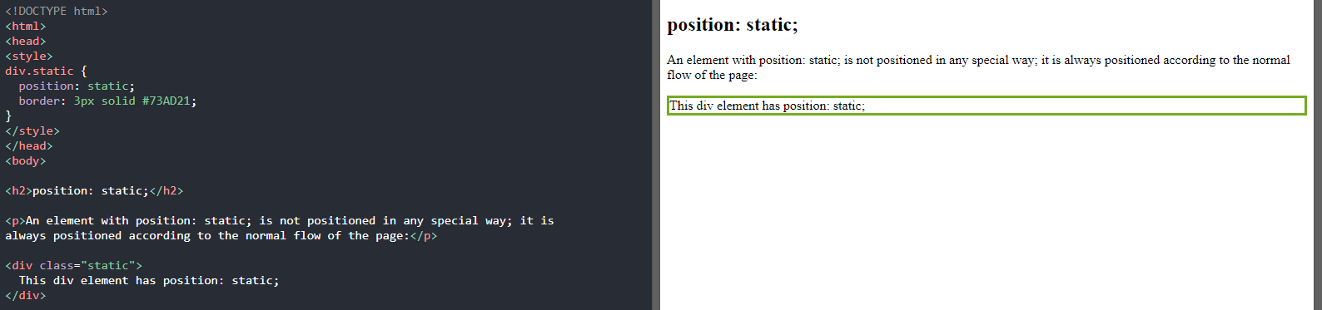
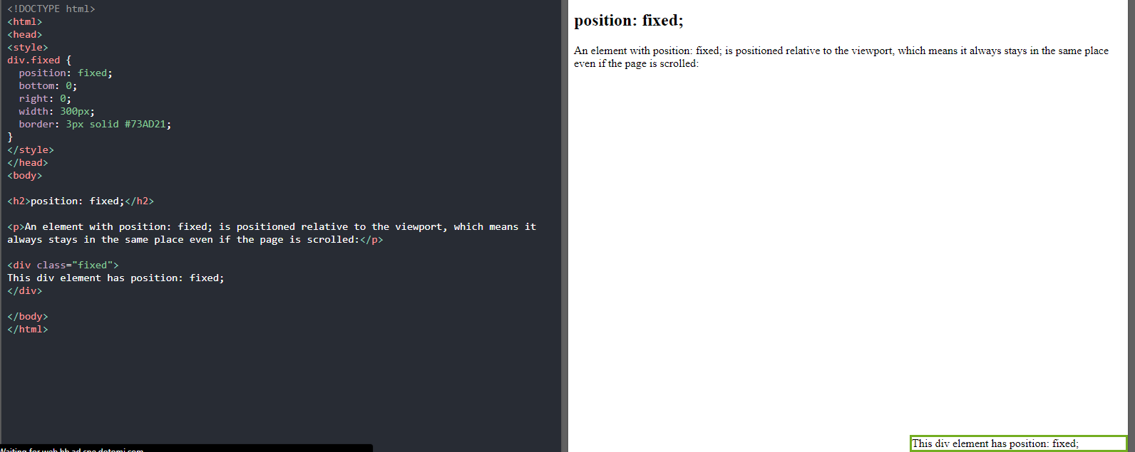
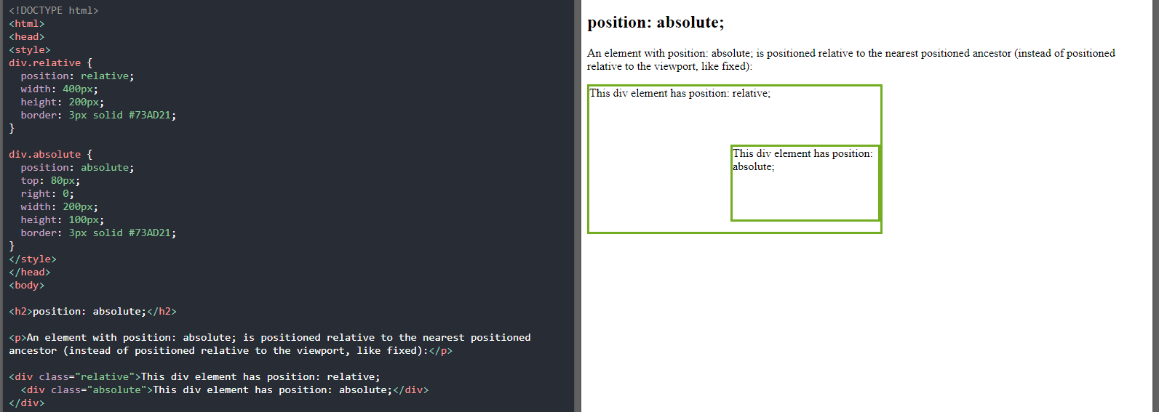
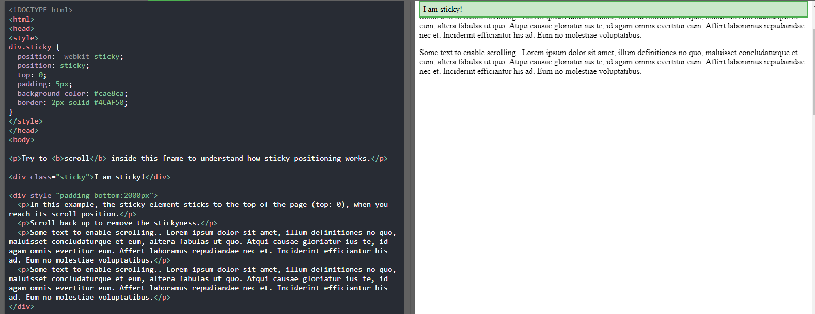
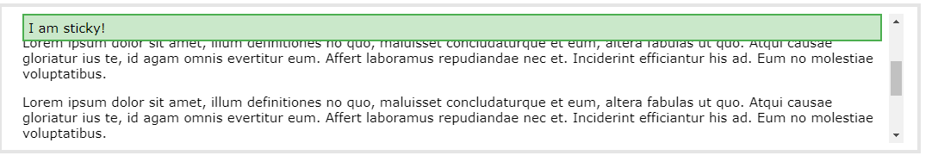
More on position

Slide 4
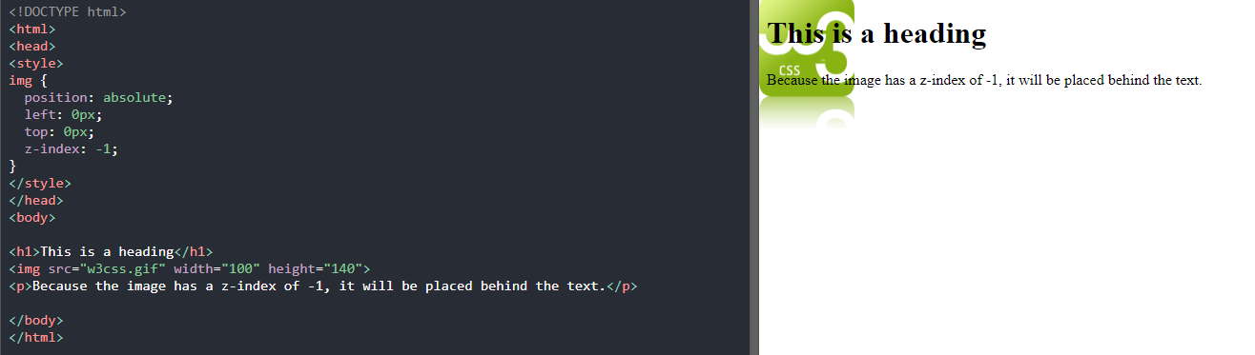
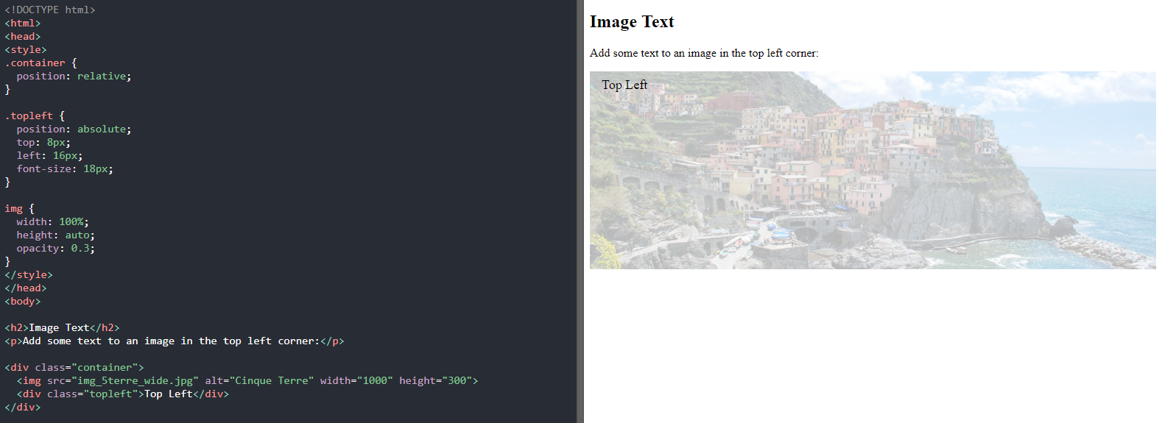
Overlapping elements
Here the z-index is used
It specifies the stack order of an element
Positioning text in an Image
Here we use directions like top, right.
The positions used are relative and absolute.

Slide 5
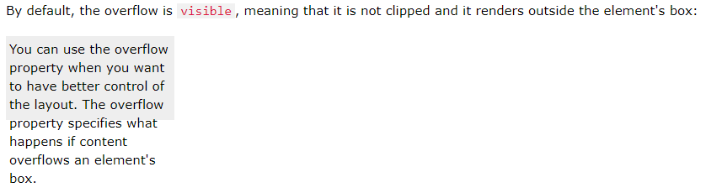
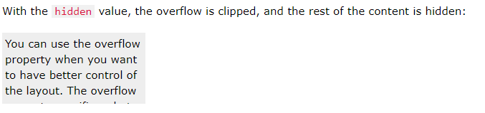
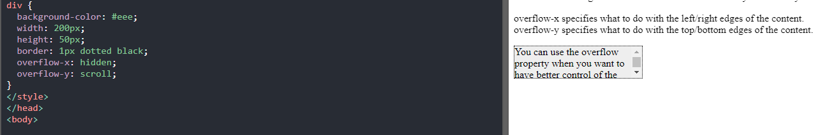
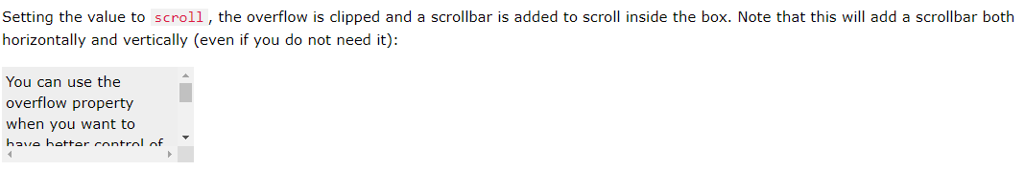
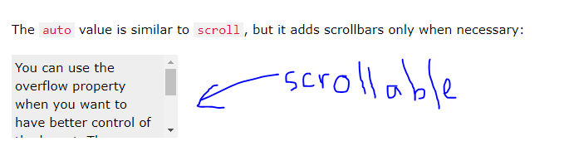
Overflow
Overflow has the following values:
Visible - Default. The overflow is not clipped. The content renders outside the element's box
Hidden - The overflow is clipped, and the rest of the content will be invisible
Scroll - The overflow is clipped, and a scrollbar is added to see the rest of the content
Auto – Similar to scroll but adds scrollbars only when necessary

Slide 6
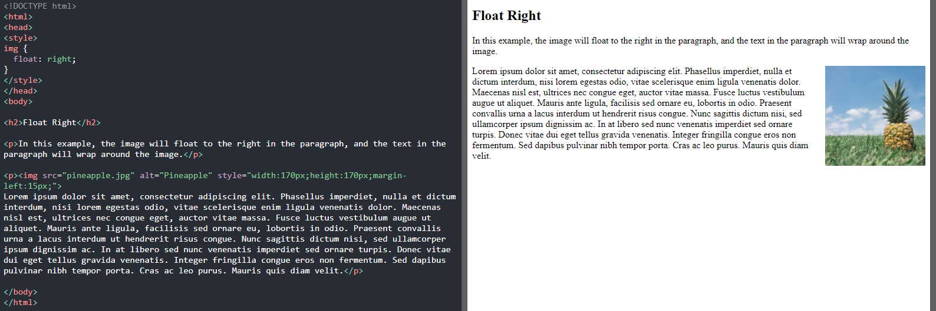
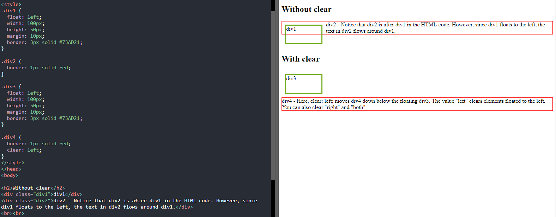
Float
Here you can make your text be on any side of the page i.e. right
And with the clear property an image can be arranged together with text.

Slide 7
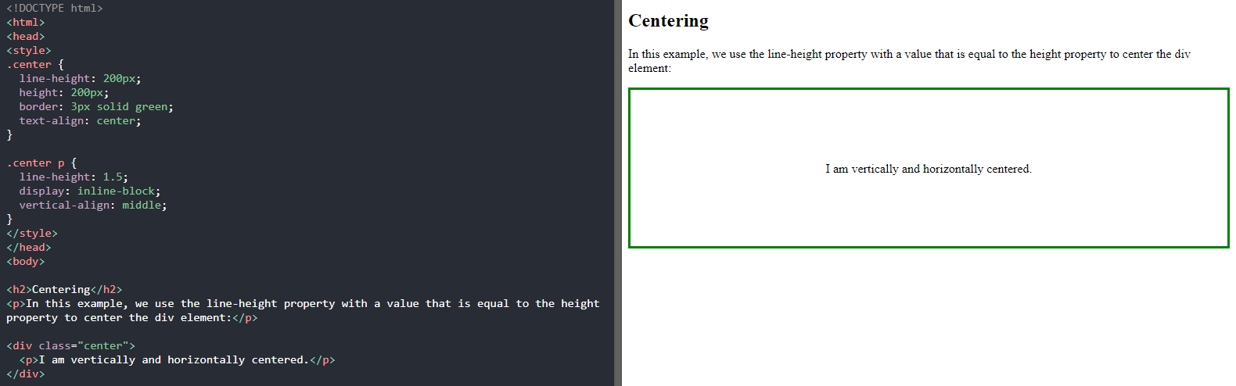
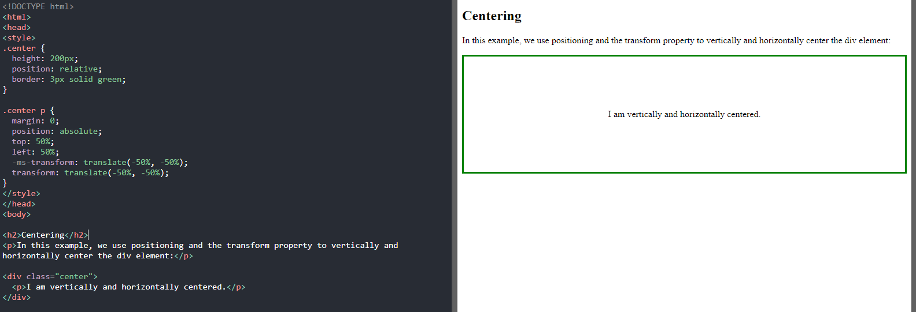
Align
We can also use the transform effect which has this code
transform: translate(-50%, -50%);
Lets find out how
Both images and text can be aligned accordingly in the web pages.
We use the align property itself.
Text-align: center;
Text-align: right;
We can also use line height if you want to vertically align your info.

Slide 8
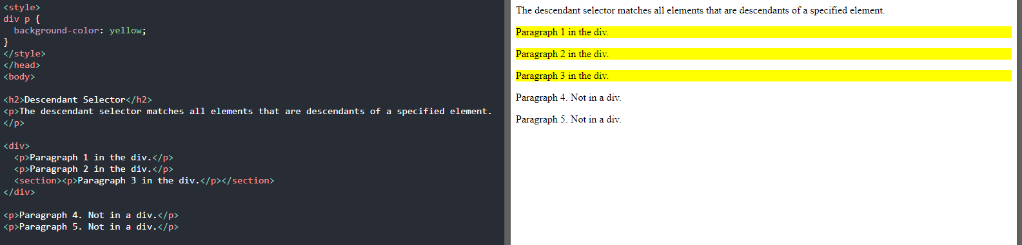
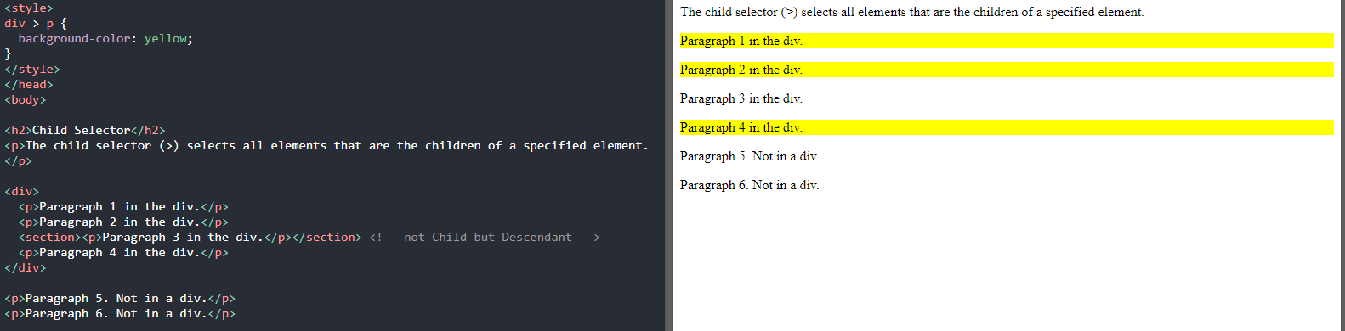
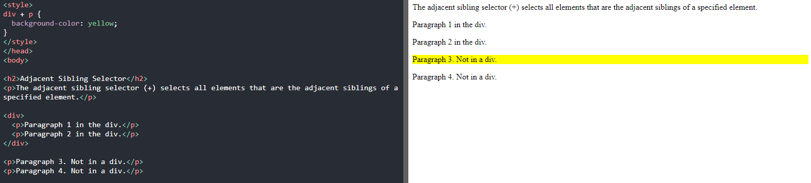
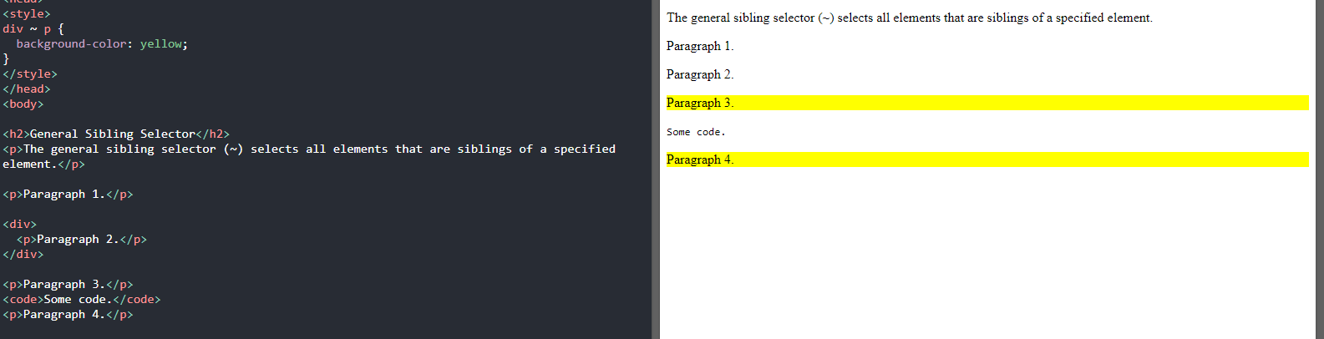
Combinators
There are four different combinators in CSS:
descendant selector (space) - The descendant selector matches all elements that are descendants of a specified element.
child selector (>) - The child selector selects all elements that are the children of a specified element.
adjacent sibling selector (+) - The adjacent sibling selector selects all elements that are the adjacent siblings of a specified element.
general sibling selector (~) - The general sibling selector selects all elements that are siblings of a specified element.

